Slide 1
Docker Webhook 組員：杜孟憲、邱冠瑾

Slide 2
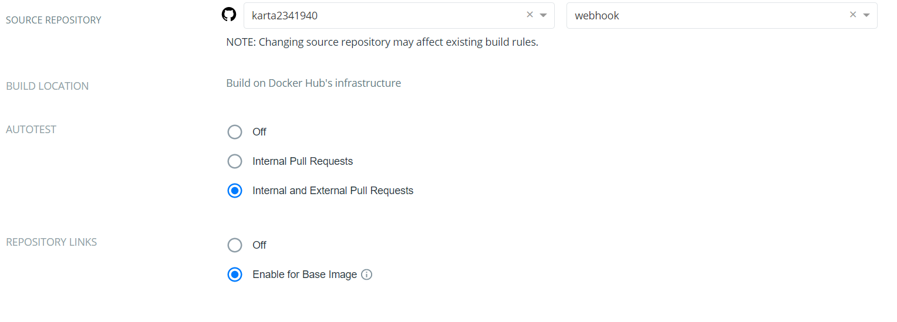
Auto test

Slide 3
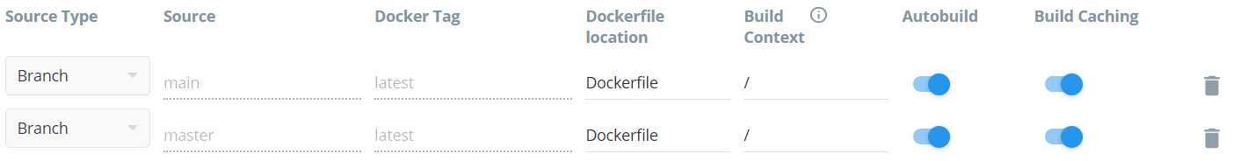

Slide 4
Compose
Compose it means make several components into a package or

Slide 5
Docker Compose
Several docker image compose to a file which can auto build a environment more faster and more easy

Slide 6
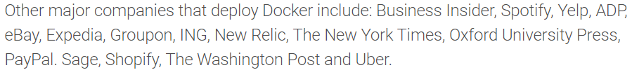

Who using docker
Link : https://www.contino.io/insights/whos-using-docker

Slide 7

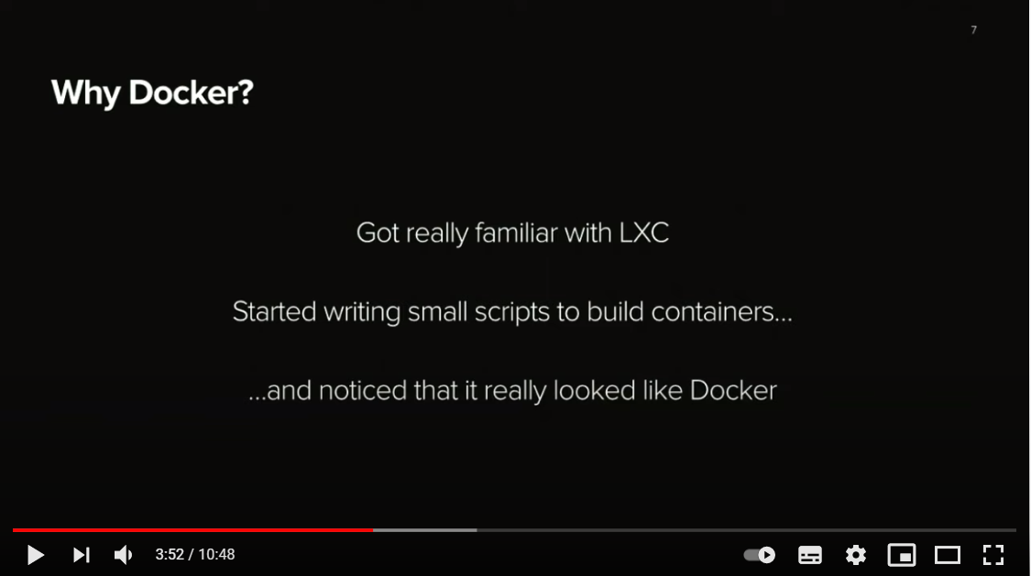
Take spotify for example
Link:https://www.youtube.com/watch?v=pts6F00GFuU

Slide 8
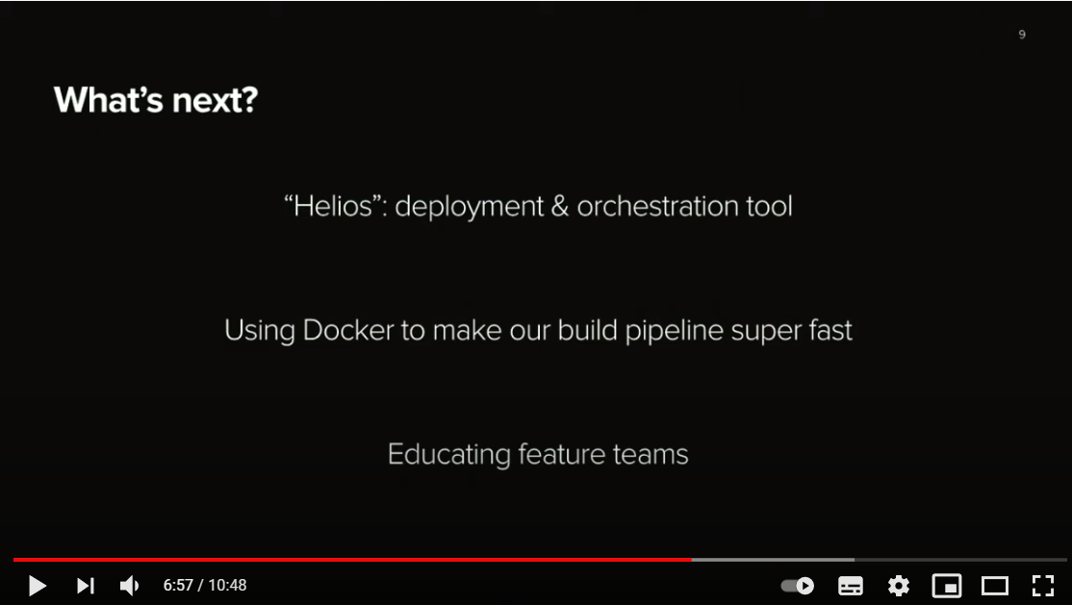
Spotify said

Slide 9
Conclusion
Docker is a very useful tool for some company
This tool can build a production pipeline very fast or build a environment in a in a sudden
Docker 好棒棒

